Slide 1
Cache and Virtual Memory
Replacement Algorithms

Slide 2
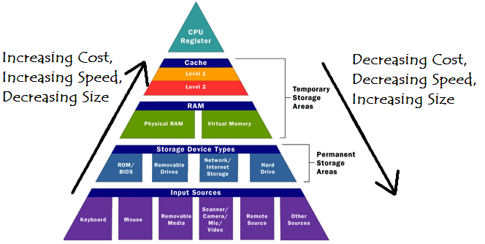
Overview

Slide 3
Central Idea of a Memory Hierarchy
Provide memories of various speed and size at different points in the system.
Use a memory management scheme which will move data between levels.
  Those items most often used should be stored in faster levels.
  Those items seldom used should be stored in lower levels.

Slide 4
Terminology
Cache: a small, fast “buffer” that lies between the CPU and the Main Memory which holds the most recently accessed data.
Virtual Memory: Program and data are assigned addresses independent of the amount of physical main memory storage actually available and the location from which the program will actually be executed.
Hit ratio: Probability that next memory access is found in the cache.
Miss rate: (1.0 – Hit rate)

Slide 5
Importance of Hit Ratio
Given:
  h = Hit ratio
  T_{a} = Average effective memory access time by CPU
  T_{c} = Cache access time
  T_{m} = Main memory access time
Effective memory time is:
  T_{a} = hT_{c} + (1 – h)T_{m}
Speedup due to the cache is:
  S_{c} = T_{m} / T_{a}
Example:
  Assume main memory access time of 100ns and cache access time of 10ns and there is a hit ratio of .9.
  T_{a} = .9(10ns) + (1 - .9)(100ns) = 19ns
  S_{c} = 100ns / 19ns = 5.26
  Same as above only hit ratio is now .95 instead:
  T_{a} = .95(10ns) + (1 - .95)(100ns) = 14.5ns
  S_{c} = 100ns / 14.5ns = 6.9

Slide 6
Cache vs Virtual Memory
Primary goal of Cache:
increase Speed.
Primary goal of Virtual Memory: increase Space.

Slide 7
Cache Mapping Schemes
1) Fully Associative (1 extreme)
2) Direct Mapping (1 extreme)
3) Set Associative (compromise)

Slide 8
Fully Associative Mapping
A main memory block can map into any block in cache.
Main Memory Cache Memory
Block 1 | 000 | Prog A
Block 2 | 001 | Prog B
Block 3 | 010 | Prog C
Block 4 | 011 | Prog D
Block 5 | 100 | Data A
Block 6 | 101 | Data B
Block 7 | 110 | Data C
Block 8 | 111 | Data D
Block 1 | 100 | Data A
Block 2 | 010 | Prog C
Italics: Stored in Memory

Slide 9
Fully Associative Mapping
Advantages:
  No Contention
  Easy to implement
Disadvantages:
  Very expensive
  Very wasteful of cache storage since you must store full primary memory address

Slide 10
Direct Mapping
Store higher order tag bits along with data in cache.
Main Memory Cache Memory
Block 1 | 000 | Prog A
Block 2 | 001 | Prog B
Block 3 | 010 | Prog C
Block 4 | 011 | Prog D
Block 5 | 100 | Data A
Block 6 | 101 | Data B
Block 7 | 110 | Data C
Block 8 | 111 | Data D
Block 1 | 00 | 0 | Prog A
Block 2 | 01
Block 3 | 10 | 1 | Data C
Block 4 | 11 | 0 | Prog D
Italics: Stored in Memory
Index bits
Tag bits

Slide 11
Direct Mapping
Advantages:
  Low cost; doesn’t require an associative memory in hardware
  Uses less cache space
Disadvantages:
  Contention with main memory data with same index bits.

Slide 12
Set Associative Mapping
Puts a fully associative cache within a direct-mapped cache.
Main Memory Cache Memory
Block 1 | 000 | Prog A
Block 2 | 001 | Prog B
Block 3 | 010 | Prog C
Block 4 | 011 | Prog D
Block 5 | 100 | Data A
Block 6 | 101 | Data B
Block 7 | 110 | Data C
Block 8 | 111 | Data D
Set 1 | 0 | 00 | Prog A | 10 | Data A
Set 2 | 1 | 11 | Data D | 10 | Data B
Italics: Stored in Memory
Index bits
Tag bits

Slide 13
Set Associative Mapping
Intermediate compromise solution between Fully Associative and Direct Mapping
  Not as expensive and complex as a fully associative approach.
  Not as much contention as in a direct mapping approach.

Slide 14
Set Associative Mapping
Cost | Degree Associativity | Miss Rate | Delta
$ | 1-way | 6.6%
$$ | 2-way | 5.4% | 1.2
$$$$ | 4-way | 4.9% | .5
$$$$$$$$ | 8-way | 4.8% | .1
Performs close to theoretical optimum of a fully associative approach – notice it tops off.
Cost is only slightly more than a direct mapped approach.
Thus, Set-Associative cache offers best compromise between speed and performance.

Slide 15
Cache Replacement Algorithms
Replacement algorithm determines which block in cache is removed to make room.
2 main policies used today
  Least Recently Used (LRU)
    The block replaced is the one unused for the longest time.
  Random
    The block replaced is completely random – a counter-intuitive approach.

Slide 16
LRU vs Random
Below is a sample table comparing miss rates for both LRU and Random.
Cache Size | Miss Rate: LRU | Miss Rate: Random
16KB | 4.4% | 5.0%
64KB | 1.4% | 1.5%
256KB | 1.1% | 1.1%
As the cache size increases there are more blocks to choose from, therefore the choice is less critical → probability of replacing the block that’s needed next is relatively low.

Slide 17
Virtual Memory Replacement Algorithms
1) Optimal
2) First In First Out (FIFO)
3) Least Recently Used (LRU)

Slide 18
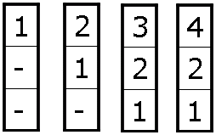

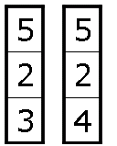
Optimal
Replace the page which will not be used for the longest (future) period of time.
Faults are shown in boxes; hits are not shown.
1 2 3 4 1 2 5 1 2 5 3 4 5
7 page faults occur

Slide 19
Optimal
A theoretically “best” page replacement algorithm for a given fixed size of VM.
Produces the lowest possible page fault rate.
Impossible to implement since it requires future knowledge of reference string.
Just used to gauge the performance of real algorithms against best theoretical.

Slide 20
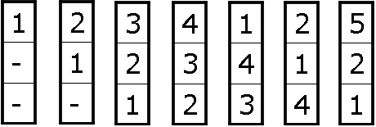
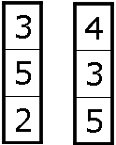
FIFO
When a page fault occurs, replace the one that was brought in first.
Faults are shown in boxes; hits are not shown.
1 2 3 4 1 2 5 1 2 5 3 4 5
9 page faults occur

Slide 21
FIFO
Simplest page replacement algorithm.
Problem: can exhibit inconsistent behavior known as Belady’s anomaly.
  Number of faults can increase if job is given more physical memory
  i.e., not predictable

Slide 22
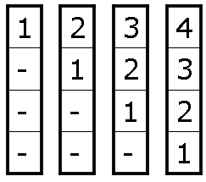
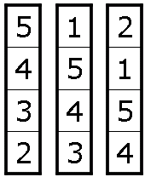
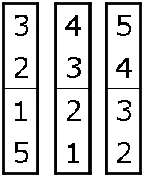
Example of FIFO Inconsistency
Same reference string as before only with 4 frames instead of 3.
Faults are shown in boxes; hits are not shown.
1 2 3 4 1 2 5 1 2 5 3 4 5
10 page faults occur

Slide 23
LRU
Replace the page which has not been used for the longest period of time.
Faults are shown in boxes; hits only rearrange stack
1 2 3 4 1 2 5 1 2 5 3 4 5
1
2
5
5
1
2
2
5
1
9 page faults occur

Slide 24
LRU
More expensive to implement than FIFO, but it is more consistent.
Does not exhibit Belady’s anomaly
More overhead needed since stack must be updated on each access.

Slide 25

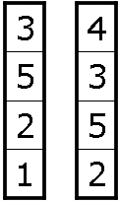
Example of LRU Consistency
Same reference string as before only with 4 frames instead of 3.
Faults are shown in boxes; hits only rearrange stack
1 2 3 4 1 2 5 1 2 5 3 4 5
1
2
1
2
5
4
1
5
1
2
3
4
2
5
1
2
3
4
4
4
7 page faults occur

Slide 26
Questions?

